Slide 1
UPPER SIXTH ARTS
GEOGRAPHY
Lesson 9
Meeting the Increasing Food Demand
Notes:
Good morning, class, and welcome to our geography lesson. I am your geography teacher, Mr Kamdem. Today we are starting Lesson 9: Meeting the Increasing Food Demand.

Slide 2
CLASS INFO
Class, Chapter and Duration
Class | Upper Sixth Arts
Chapter | Module 6: Understanding and managing the dynamics of economic activities across the world in general and Cameroon in particular
Duration | 2 periods (2 × 50 minutes)
Notes:
This lesson is for Upper Sixth Arts. It belongs to Module 6: Understanding and managing the dynamics of economic activities across the world in general and Cameroon in particular. We shall need 2 periods to cover it.

Slide 3
IDENTIFICATION
Lesson Identification
Topic | Developments in Agriculture
Sub-topic | Developments in Agriculture
Lesson | Lesson 9: Meeting the Increasing Food Demand
Notions / Concepts | Food security, food shortage, intensification, extensification, food aid, distribution.
Syllabus focus | Global food supply and demand; solutions: improving farming, industrialisation and new foods, distribution, rural development, demographic control.
Competence | Learners are able to explain the food problem and propose solutions.
Notes:
Our topic is Developments in Agriculture, and the sub-topic is Developments in Agriculture. The key notions we shall use today are: food security, food shortage, intensification, extensification, food aid, distribution. At the end, you should be able to do this: learners are able to explain the food problem and propose solutions.

Slide 4

HOMEWORK CORRECTION
Correction of the Homework
Question (Lesson 8: Agricultural Improvements: The Green Revolution):
Ask a farmer if he uses improved seeds and fertiliser and what results he gets.
Notes:
Before we start the new lesson, let us correct the homework I gave you at the end of Lesson 8: Agricultural Improvements: The Green Revolution. The question was: Ask a farmer if he uses improved seeds and fertiliser and what results he gets. Take out your exercise books.

Slide 5
HOMEWORK CORRECTION
Correction: Possible Answer
Example: the farmer uses improved maize seed and NPK fertiliser and harvests about 3 tonnes per hectare instead of 1 tonne, but complains that fertiliser is expensive.
Notes:
Here is a good answer. Example: the farmer uses improved maize seed and NPK fertiliser and harvests about 3 tonnes per hectare instead of 1 tonne, but complains that fertiliser is expensive. Compare it with your own answer and correct your work in red.

Slide 6
LESSON PLAN
Lesson Plan
Correction of the homework
Objectives and recall
Real-life situation and action to take
Learning activities
Board summary
Evaluation, remediation and homework
Notes:
Here is the plan of our lesson today. First, we shall correct the homework. Then we shall look at the objectives and recall what you already know. After that, we shall study a situation from real life and the action to take, and do the learning activities. Finally, we shall copy the board summary, do the evaluation and the remediation, and I will give you the homework.

Slide 7
OBJECTIVES
Objectives
By the end of this lesson, you should be able to:
Describe the world food situation.
Explain ways of increasing food supply.
Explain other solutions (distribution, rural development, population).
Notes:
By the end of this lesson, you should be able to do three things. Number 1: describe the world food situation. Number 2: explain ways of increasing food supply. Number 3: explain other solutions (distribution, rural development, population).

Slide 8
PREVIOUS KNOWLEDGE
Previous Knowledge
World population is growing.
The Green Revolution raised yields.
Notes:
Let us first remember what you already know. World population is growing. The Green Revolution raised yields. Keep this in mind, because we shall build on it today.

Slide 9
REAL-LIFE SITUATION
Situation in Real Life
The world produces enough food for everyone, yet about 700 million people are hungry, many in Africa. In the Far North of Cameroon, droughts and insecurity cause food shortages.
Notes:
Listen carefully to this situation from real life. The world produces enough food for everyone, yet about 700 million people are hungry, many in Africa. In the Far North of Cameroon, droughts and insecurity cause food shortages. Think about it, because I am going to ask you some questions.

Slide 10
REAL-LIFE SITUATION
Situation: Question 1
What is the problem in the situation?
Notes:
Question 1: What is the problem in the situation? Think for a moment, then raise your hand to answer.

Slide 11
REAL-LIFE SITUATION
Answer
People are hungry although the world has enough food.
Notes:
Good. People are hungry although the world has enough food.

Slide 12
REAL-LIFE SITUATION
Situation: Question 2
Why?
Notes:
Question 2: Why? Think for a moment, then raise your hand to answer.

Slide 13
REAL-LIFE SITUATION
Answer
Poverty, poor distribution, droughts and conflicts.
Notes:
Good. Poverty, poor distribution, droughts and conflicts.

Slide 14
REAL-LIFE SITUATION
Situation: Question 3
Name one solution.
Notes:
Question 3: Name one solution. Think for a moment, then raise your hand to answer.

Slide 15
REAL-LIFE SITUATION
Possible Answer
Improving farming or distribution.
Notes:
Good. Improving farming or distribution.

Slide 16
ACTION TO TAKE
Action to Take
Contribute to food security through better farming and distribution.
Notes:
From this situation, the action we are working towards in this lesson is the following: contribute to food security through better farming and distribution.

Slide 17
JUSTIFICATION
Justification of the Lesson
This lesson helps us to think about how to feed a growing population.
Notes:
Why is this lesson important for you? This lesson helps us to think about how to feed a growing population.

Slide 18
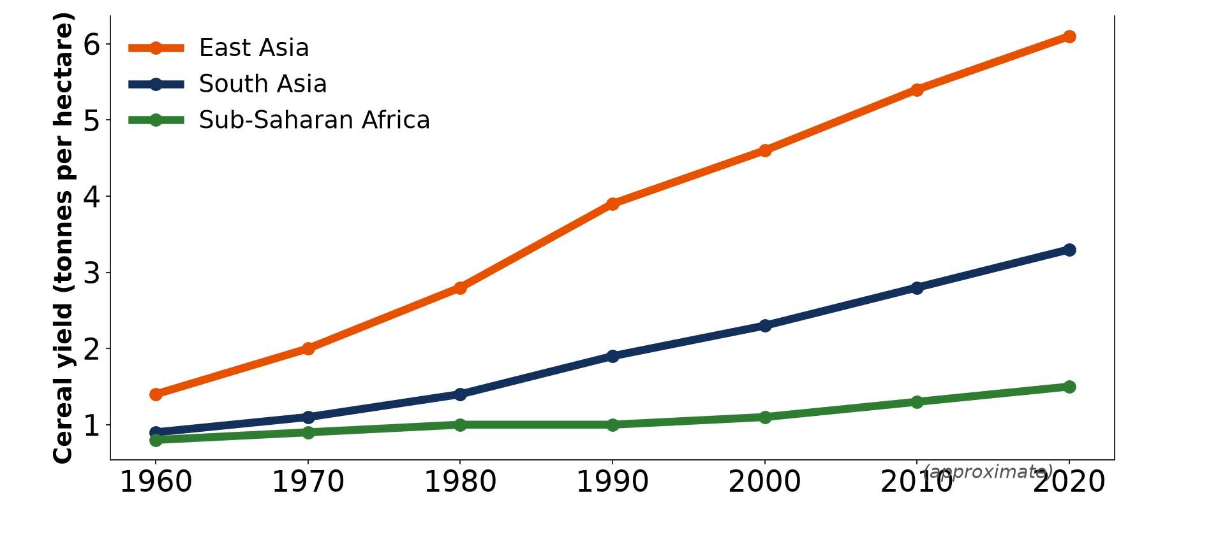
1. GLOBAL SITUATION
Activity 1
Cereal yields (approximate).
Notes:
Activity 1. Look carefully at this diagram: cereal yields (approximate). Observe every detail before I ask the question.

Slide 19
1. GLOBAL SITUATION
Activity 1: Question
Why is food a problem in Sub-Saharan Africa?
Notes:
Here is the question for Activity 1: Why is food a problem in Sub-Saharan Africa? Take one minute to think and write your answer in your rough notebook.

Slide 20
1. GLOBAL SITUATION
Activity 1: Answer
Yields are low while population grows fast.
Notes:
Let us check the answer together. Yields are low while population grows fast.

Slide 21
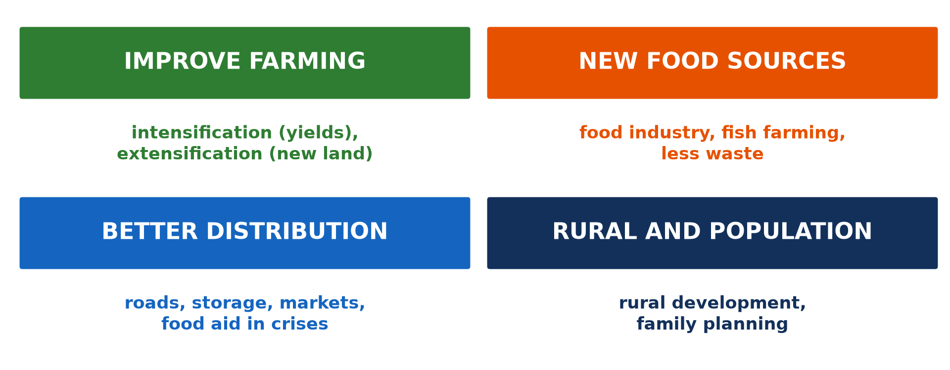
2. A) IMPROVING FARMING
Activity 2
Ways to meet food demand.
Notes:
Activity 2. Look carefully at this diagram: ways to meet food demand. Observe every detail before I ask the question.

Slide 22
2. A) IMPROVING FARMING
Activity 2: Question
Distinguish intensification and extensification.
Notes:
Here is the question for Activity 2: Distinguish intensification and extensification. Take one minute to think and write your answer in your rough notebook.

Slide 23
2. A) IMPROVING FARMING
Activity 2: Answer
Intensification raises yields on the same land; extensification farms new land.
Notes:
Let us check the answer together. Intensification raises yields on the same land; extensification farms new land.

Slide 24
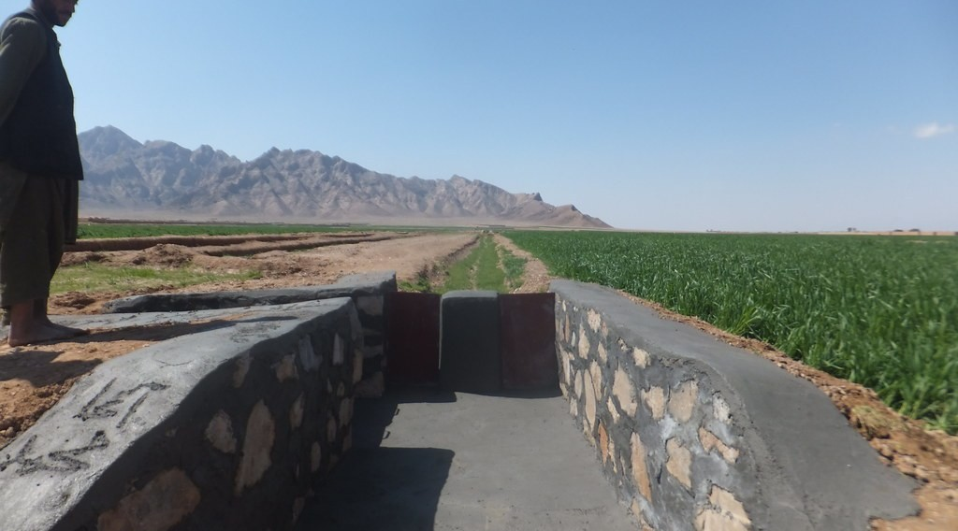
2. A) IMPROVING FARMING
Activity 3
An irrigation canal.
Notes:
Activity 3. Look carefully at this picture: an irrigation canal. Observe every detail before I ask the question.

Slide 25
2. A) IMPROVING FARMING
Activity 3: Question
How does irrigation increase food supply?
Notes:
Here is the question for Activity 3: How does irrigation increase food supply? Take one minute to think and write your answer in your rough notebook.

Slide 26
2. A) IMPROVING FARMING
Activity 3: Answer
It allows crops in the dry season and higher yields.
Notes:
Let us check the answer together. It allows crops in the dry season and higher yields.

Slide 27

2. C) IMPROVING DISTRIBUTION
Activity 4
Food aid distribution.
Notes:
Activity 4. Look carefully at this picture: food aid distribution. Observe every detail before I ask the question.

Slide 28
2. C) IMPROVING DISTRIBUTION
Activity 4: Question
Why is food aid only a short-term solution?
Notes:
Here is the question for Activity 4: Why is food aid only a short-term solution? Take one minute to think and write your answer in your rough notebook.

Slide 29
2. C) IMPROVING DISTRIBUTION
Activity 4: Answer
It helps in crises but can harm local farmers and create dependence.
Notes:
Let us check the answer together. It helps in crises but can harm local farmers and create dependence.

Slide 30

2. OTHER WAYS
Activity 5
A food market.
Notes:
Activity 5. Look carefully at this picture: a food market. Observe every detail before I ask the question.

Slide 31
2. OTHER WAYS
Activity 5: Question
Give two other solutions to food shortage.
Notes:
Here is the question for Activity 5: Give two other solutions to food shortage. Take one minute to think and write your answer in your rough notebook.

Slide 32
2. OTHER WAYS
Activity 5: Answer
Better roads and storage; family planning (also rural development).
Notes:
Let us check the answer together. Better roads and storage; family planning (also rural development).

Slide 33
BOARD SUMMARY
Board Summary
Topic: Developments in Agriculture
Sub-topic: Developments in Agriculture
Lesson 9: Meeting the Increasing Food Demand
Notes:
Now we are going to copy the board summary. Write the title and the headings neatly in your notebooks. I will give you enough time for each slide, so do not rush.

Slide 34
BOARD SUMMARY
1. Global Situation of Food Supply and Demand
The world food situation is as follows:
Supply and demand: The world produces enough food for everyone, but about 700 million people are hungry. Demand rises with population growth and changing diets.
Notes:
Let us copy Global Situation of Food Supply and Demand. The world food situation is as follows. On this slide we have Supply and demand. Write each point on a new line, with the key term first, and explain it in your own words when we revise. When you finish, we go to the next slide.

Slide 35
BOARD SUMMARY
1. Global Situation of Food Supply and Demand (continued)
Inequality: Food shortage is worst in Sub-Saharan Africa and South Asia, because of poverty, drought, conflicts and poor transport. Rich countries have surpluses and waste.
Notes:
We continue with Global Situation of Food Supply and Demand. On this slide we have Inequality. Write each point on a new line, with the key term first, and explain it in your own words when we revise.

Slide 36
BOARD SUMMARY
1. Global Situation of Food Supply and Demand
Illustration: cereal yields by region
Notes:
Now draw this illustration in your notebook: cereal yields by region. Give it a title and label it clearly.

Slide 37
BOARD SUMMARY
2. Ways of Solving the Problem
The main solutions are:
Improving farming: Intensification raises yields on existing land with irrigation, fertilisers and improved seeds. Extensification brings new land under cultivation.
Notes:
Let us copy Ways of Solving the Problem. The main solutions are. On this slide we have Improving farming. Write each point on a new line, with the key term first, and explain it in your own words when we revise. When you finish, we go to the next slide.

Slide 38
BOARD SUMMARY
2. Ways of Solving the Problem (continued)
Industrialisation and other food sources: Food processing, storage and fish farming increase supply. Reducing waste and finding new foods also help.
Notes:
We continue with Ways of Solving the Problem. On this slide we have Industrialisation and other food sources. Write each point on a new line, with the key term first, and explain it in your own words when we revise. When you finish, we go to the next slide.

Slide 39
BOARD SUMMARY
2. Ways of Solving the Problem (continued)
Improving distribution: Better roads, markets, storage and food aid in emergencies bring food where it is needed. Food aid is only a short-term solution.
Notes:
We continue with Ways of Solving the Problem. On this slide we have Improving distribution. Write each point on a new line, with the key term first, and explain it in your own words when we revise. When you finish, we go to the next slide.

Slide 40
BOARD SUMMARY
2. Ways of Solving the Problem (continued)
Rural development and demographic control: Credit, education and services keep farmers on the land and raise productivity. Family planning slows the growth of demand.
Notes:
We continue with Ways of Solving the Problem. On this slide we have Rural development and demographic control. Write each point on a new line, with the key term first, and explain it in your own words when we revise.

Slide 41
BOARD SUMMARY
2. Ways of Solving the Problem
Illustration: solutions to food shortage
Notes:
Now draw this illustration in your notebook: solutions to food shortage. Give it a title and label it clearly.

Slide 42
FORMATIVE EVALUATION
Evaluation 1
Why are people hungry although the world has enough food?
Notes:
Now let us check what you have understood. Question 1: Why are people hungry although the world has enough food? Answer in your exercise book.

Slide 43
FORMATIVE EVALUATION
Expected Answer
Poverty, conflicts and poor distribution.
Notes:
The expected answer is: poverty, conflicts and poor distribution. If you got it right, well done.

Slide 44
FORMATIVE EVALUATION
Evaluation 2
Give three ways of meeting food demand.
Notes:
Now let us check what you have understood. Question 2: Give three ways of meeting food demand. Answer in your exercise book.

Slide 45
FORMATIVE EVALUATION
Expected Answer
Irrigation, better distribution, family planning (also new land, food processing).
Notes:
The expected answer is: irrigation, better distribution, family planning (also new land, food processing). If you got it right, well done.

Slide 46
REMEDIATION
Remediation
Fill in the blanks:
Enough safe food for all is food ______.
Farming new land is ______.
Food aid is a ______-term solution.
Notes:
For those who need more practice, fill in the blanks in your exercise book. The answers are: number 1, security; number 2, extensification; number 3, short.

Slide 47
HOMEWORK
Homework
Suggest three measures to reduce food shortage in the Far North.
Notes:
For your homework: Suggest three measures to reduce food shortage in the Far North. We shall correct it at the beginning of our next lesson.

Slide 48
NEXT LESSON
Next Lesson
Our next lesson will be on:
Lesson 10: Impacts of Agriculture on the Environment
Notes:
Our next lesson will be on Lesson 10: Impacts of Agriculture on the Environment. Thank you for your attention, and see you next time.

Slide 49
BILINGUAL GAME
Bilingual Game (Jeu Bilingue)
English | Français
Food security | La sécurité alimentaire
Hunger | La faim
Food aid | L'aide alimentaire
Storage | Le stockage
Shortage | La pénurie
Demand | La demande
Notes:
Let us play the bilingual game. I say a word in English, and you give me the French word. Then we do the reverse.

Slide 50
LOGBOOK
Official Logbook (1/2)
Module / Topic | Developments in Agriculture
Lesson Title | Lesson 9: Meeting the Increasing Food Demand
Expected Learning Outcomes | Describe the world food situation. Explain ways of increasing food supply. Explain other solutions (distribution, rural development, population).
Competence | Learners are able to explain the food problem and propose solutions.
Notes:
I record this information in the official logbook of the class after the lesson.

Slide 51
LOGBOOK
Official Logbook (2/2)
Matter Taught | Global Situation of Food Supply and Demand; Ways of Solving the Problem.
Evaluation | Formative evaluation and remediation exercise.
Homework | Suggest three measures to reduce food shortage in the Far North.
Enrolment / Present / Absent | ____ / ____ / ____
Achievement | To be completed after the lesson.
Notes:
I complete the second page of the logbook: the matter taught, the evaluation, the homework and the attendance.

Slide 52
TEACHER'S NOTE
Teacher's Note
Timing: Homework correction, plan, objectives 8 min | Recall, situation, action 10 min | 5 activities 30 min | Board summary (copying) 30 min | Evaluation, remediation 10 min | Homework, next lesson 5 min | Logbook 7 min
Without the projector (Activity 1): read the graph.
Without the projector (Activity 2): copy the four boxes.
Without the projector (Activity 3): mention SEMRY.
Without the projector (Activity 4): discuss food aid.
Without the projector (Activity 5): list solutions.
Notes:
This slide is for me, the teacher: it gives the timing of the lesson and what to do if the projector is not available.

Slide 53
REFERENCES
References
National Geography Syllabus, MINESEC/IGE/IP-SS, 2019 — Module 6 (Economic Geography).
Photo, Activity 3: “Irrigation Canals in Farah Province Afgahnistan” by USAID_IMAGES, CC BY-NC-ND 2.0, via Flickr (https://www.flickr.com/photos/46658241@N06/14784748647)
Photo, Activity 4: “WFP food distribution” by UNAMID Photo, CC BY-NC-ND 2.0, via Flickr (https://www.flickr.com/photos/58538810@N03/12495227734)
Photo, Activity 5: “Sandga Market in Douala, Cameroon” by The Advocacy Project, CC BY-NC-SA 2.0, via Flickr (https://www.flickr.com/photos/42487558@N00/3636438732)
Diagrams and animations: drawn for this lesson (Geography Department).
Notes:
These are the references and picture credits used to prepare this lesson.

